Slide 1
abortion today: WHAT WOMEN NEED and WANT
Marge Berer
Coordinator, International Campaign for Women's Right to Safe Abortion
+++++++++++
Founder Editor, Reproductive Health Matters

Slide 2
Total fertility rate globally = almost 2
Average age of menarche falling, average age in UK at 13, but as low as 8 in Mexico.
Menopause happening later, average age in UK is 52. Means a woman has ± 40 fertile years.
Even with high contraceptive use, e.g. in UK, one in three women has an abortion in her lifetime and a third of those will have more than one abortion (Stone/Ingham) = a very low failure rate considering the time involved, but substantial numbers.
Where far fewer women using modern methods (Somalia 1%), the need for abortion is even higher.

Slide 3
If we want the family planning community to embrace women's need for abortion, we need to embrace women's need for contraception.

Slide 4
Main reasons for not using a contraceptive method = need for abortion
Married women aged 15-49 global South | Young, unmarried women
Infrequent sex | Lack of access to contraceptive education, information, services
Side effects/health risks | Unwilling to risk social disapproval associated with seeking services
Opposition from others | Infrequent sex
Post-partum amenorrhea/breastfeeding | ALL
Sub-fecundity | Sexual abuse (Rwanda)
Lack of access | Rape a weapon of war 21 countries
Lack of knowledge
(Sedgh & Hussain, 2014; Umuhoza, 2013; UN report 2014))

Slide 5
none of these reasons is stupid or irresponsible.

Slide 6
Yet abortion is still treated as a problem…
Stigmatising language about abortion
We are all against abortion, even if we know it’s necessary.
No woman should have to die giving life.
We must reduce problems like STIs and abortions.
… ambivalent language often used by those who support contraception and SRH.
So abortion becomes and remains a problem…

Slide 7
Children, adolescents and young women
Adolescents and young people experience the most unwanted pregnancies (and STIs and HIV) ‒ have the most sex and least access to services.
Among the 21.6 million women each year with unsafe abortions, adolescents suffer the most from complications and have the highest unmet need for contraception ‒ yet are still not perceived as eligible for “family planning” in many countries.
Sexual abuse and rape are rampant
In Paraguay, 600 girls aged 14 and under become pregnant each year in a country of 6.8 million people. (http://www.cbc.ca/news/world/protests-in-paraguay-where-abortion-is-illegal-in-case-of-10-year-old-rape-victim-1.3070439 )
Thousands of children in the US give birth each year. (US Centers for Disease Control)

Slide 8
Global policy: "FP vs. abortion" democratic deficit
ICPD 1994 ‒ a wider definition and concept of SRHR was agreed, positive emphasis on family planning, but right to abortion fatally compromised.
MDGs omitted any reference to family planning and abortion; access to reproductive health inserted late, never promoted.
Post-2015 agenda problems about including SRHR; abortion is almost entirely invisible despite an important statement by the UN SG recently.
ICPD+20 and Beijing+20 outcomes disappointing, stuck in the past.
FP 2020 ‒ only “unmet need” recognised is for contraception.
European donors' positive policies supporting safe abortion, contrasted with USAID/Gates funding for PAC only.
Global Strategy for Women’s, Children’s and Adolescents’ Health 2015 ‒ unsafe abortion mentioned only once re adolescents.

Slide 9
Abortion is a solution for women

Slide 10
Women also need…

Slide 11
Us to sort out our terminology
WHO decided to call it medical abortion. When will you Americans stop calling it medication abortion? It's confusing for women.
Stop calling it "gestational age". This language is about the baby that is going to be aborted. For women, it's about the number of weeks they've been pregnant ‒ how far gone they are, when they saw their last period.

Slide 12
Research to improve efficacy of medical abortion
The efficacy of medical abortion very early in pregnancy is now clear but studies so far are small. We should be confirming use as soon as a woman gets a positive pregnancy test.
Improvements in WHO recommended abortion methods, especially very early medical methods that woman can obtain from a pharmacy or other provider and use at home. But beyond early, more efficacious medical methods overall.
Instability of misoprostol tablets stored outside the blister has been identified. This is a potentially serious concern for clinical outcome in medical abortion, especially where women are ordering tablets over the internet and/or sharing them with each other in clandestine settings. (Berard V et al, 2014)

Slide 13
Research that crosses the line between contraception and abortion with new methods
In addition to existing methods, we need methods that act when administered after fertilisation that:
could be used for more days after unprotected sex than current emergency contraceptives, and
could be used only on the relatively rare occasions when menstrual period is delayed.
(Raymond EG, et al, 2013)
Multipurpose methods (currently focused on combining contraception + anti-STI/HIV) that are also abortifacient.

Slide 14
Evidence from existing research/guidance acted upon
Randomized, controlled trials 1977‒1995 on safety and effectiveness of task-shifting found little or no difference in contraceptive outcomes between doctors with:
IUD insertion by nurses and auxiliary nurse-midwives
Tubal ligation by midwives
Vasectomy by medical students. (Polus S, et al. 2015)
In spite of numerous studies showing medical abortion can also be provided by nurses, midwives and GPs, and WHO Safe Abortion Guidance recommending replacing abortion provision at primary care level, happening only in a few countries.
D&C, still widely practised by ob-gyns, must be stopped.

Slide 15
Universal approval for mifepristone
In the majority of countries, the absence of mifepristone is a scandal. Misoprostol alone is not good enough,even if it's a lot better than knitting needles.
Where abortion is widely self-induced, there is great need for mifepristone to reduce the need for PAC.
It took 20 years in South Africa after the abortion law was reformed before mifepristone ‒ as well as misoprostol ‒ was allowed in public hospitals. (Grossman DA et al 2015)
And Canada, since 1989, one of the only two countries with no law criminalising or restricting abortion, has only just approved mifepristone but for too high a price.

Slide 16
Improvements in service delivery
In legally restricted settings, e.g. Senegal where PAC permitted
Although state health authorities have championed MVA as the “preferred” PAC technology, USAID, their primary PAC donor, does not support the purchase of abortion methods. A study in 3 hospitals found that while MVA was the most frequently employed form of uterine evacuation, concerns about "off-label" MVA practices (i.e. to carry out abortions) contributed to the persistence of less effective methods, esp. D&C, and constrained integration of MVA into routine obstetric care. (Siri Suh, 2015)
In legal settings, e.g. New Zealand
Women are still currently forced to wait up to 3‒4 weeks for an abortion, today only 56% of abortions are done before 10 weeks. (ALRANZ Newsletter, May 2015)

Slide 17
Condemn medical abuse, such as refusal to provide pain relief or the use of caesarean section to avoid doing a second trimester abortion that would be illegal (Argentina) or to save the life of the baby when the woman has asked for an abortion (Ireland, Paraguay).

Slide 18
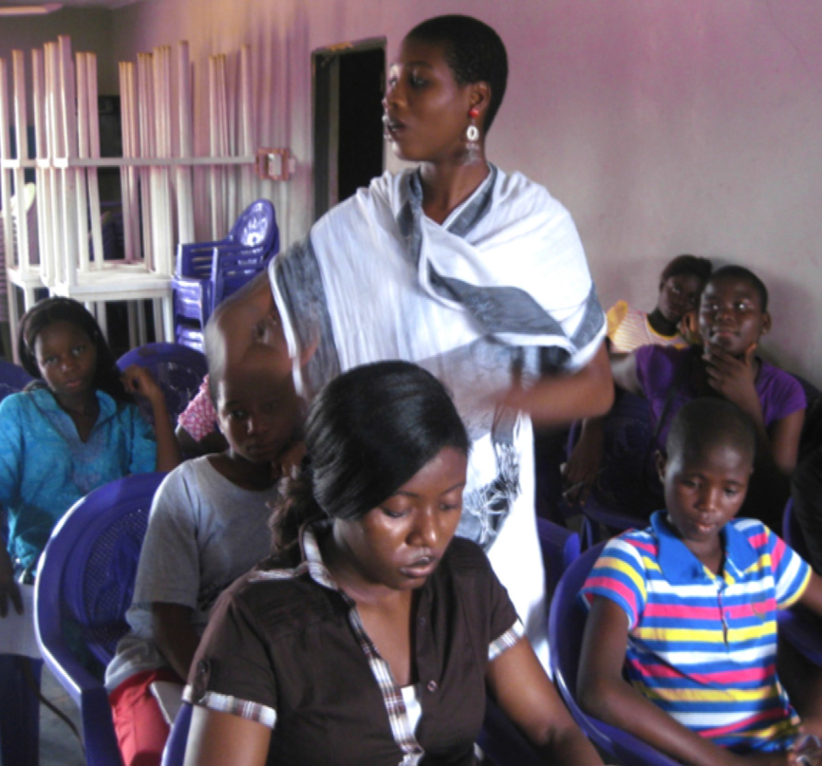
Sexuality education for adolescent girls and boys.

Slide 19
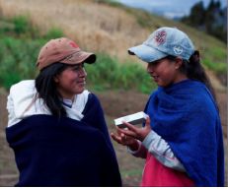
Training for primary care and community-based providers

Slide 20
Information for women so that they can have a safe abortion as early as possible.

Slide 21
Turning self-help into health service policy
Self-help abortions have been implemented by two or three generations of women in the last 50 years ‒ in the 1960s and 1970s services like Jane in Chicago, similar ones in the UK and Australia and France, in which trained health professionals did abortions using D&C or vacuum aspiration, and non-medical women trained to do them too.
Since the late 1980s, the women’s grapevine has shared information about misoprostol. In the last 10 years Safe Abortion Information Hotlines have been set up in Latin America, Asia and Africa, in order to inform/support women.
Services like Women on Web, Women Help Women and safe2choose are providing information and pills via internet. As a result, unsafe abortions have become safer, shown already in 1989 by Aníbal Faúndes in Brazil and this year by Drovetta in 5 Latin American countries (RHM 2015). But they are still not safe enough.

Slide 22
Harm reduction ≠ the absence of harm

Slide 23
Value and limitations of self-help abortions
The downsides of self-help are: women seeking information and pills on the internet without knowing whether the pills are safe and effective, nor who is a trusted provider.
The definition of what is “safe” is therefore relative.
Having an abortion alone is not always a good thing.
Having abortion at home is clearly a good thing for many women. But for others, “home” is not a safe place where privacy is possible, and not a place where the other people living there are necessarily aware or supportive.
In this sense, the role of a clinic where you can have or go through the abortion and/or being able to call an abortion hotline, where there is access to a supportive, knowledgeable person 24 hours a day, is a crucial part of any good quality approach to providing abortion care.
The line between over-medicalisation & under-medicalisation is crucial.

Slide 24
Abortion to be decriminalised and available on a woman's request.

Slide 25
Campaign for safe abortion: women's right !
Demonstration against anti-abortion bill, Spain February 2014

Slide 26
Thank you very much!!!

Slide 27
Sources 1
Prof. Hans Rosling, www.gapminder.org.
Stone N, Ingham R. Who presents more than once? Repeat abortion among women in Britain. Journal of Family Planning & Reproductive Health Care 2011;37(4):209-15.
Sedgh G, Hussain R. Reasons for contraceptive nonuse among women having unmet need for contraception in developing countries. Studies in Family Planning 2014; 45[2]: 151–169.
Umuhoza C et al. Advocating for safe abortion in Rwanda: how young people and the personal stories of young women in prison brought about change. RHM 2013;21(41):49-56.
For victims of wartime rape, abortion out of reach. http://womensenews.org/story/international-policyunited-nations/150427/victims-wartime-rape-abortion-out-reach
Polus S, et al. Optimizing the delivery of contraceptives in low- and middle-income countries through task shifting: a systematic review of effectiveness and safety. Reproductive Health 2015;12:27.
Raymond EG, et al. Embracing post-fertilisation methods of family planning: a call to action. Journal of Family Planning & Reproductive Health Care 2013; 39(4).
WHO. Safe Abortion: Technical and Policy Guidance for Health Systems. Geneva; 2012.

Slide 28
Sources 2
Siri Suh. “Right tool,” wrong “job”: Manual vacuum aspiration, post-abortion care and transnational population politics in Senegal. Social Science & Medicine 2015;135: 56–66.
Berard V et al. Instability of misoprostol tablets stored outside the blister: a potential serious concern for clinical outcome in medical abortion. PLoS One 2014;9(12):e112401.
Chong E et al. What happens when medical abortion services give women the option of taking mifepristone home? Contraception 2015;91(5):429.
Grossman DA et al. Introduction of the mifepristone regimen for second-trimester medical abortion in South Africa. Contraception 2015;91(5):426-7.
Drovetta RI. Safe abortion information hotlines: an effective strategy for increasing women’s access to safe abortions in Latin America. Reproductive Health Matters. 2015;23(45). In press.
Feature: Children and parents protest in Paraguay in the case of the 10-year-old girl refused an abortion by the state. 11 May 2015. International Campaign for Women's Right to Safe Abortion. From: http://www.cbc.ca/news/world/protests-in-paraguay-where-abortion-is-illegal-in-case-of-10-year-old-rape-victim-1.3070439 .

